Slide 1

The Product Comparison AI
Eric Golde
Notes:
Hello, this is my product comparison project for AI

Slide 2
A little backstory
Notes:
I worked at home depot over the summer, and the most common question I got was
[NEXT SLIDE]
What’s the difference between these two products?
These two lawnmowers are perfect examples of the types of products id be asked to compare on a day to day basis.

Slide 3
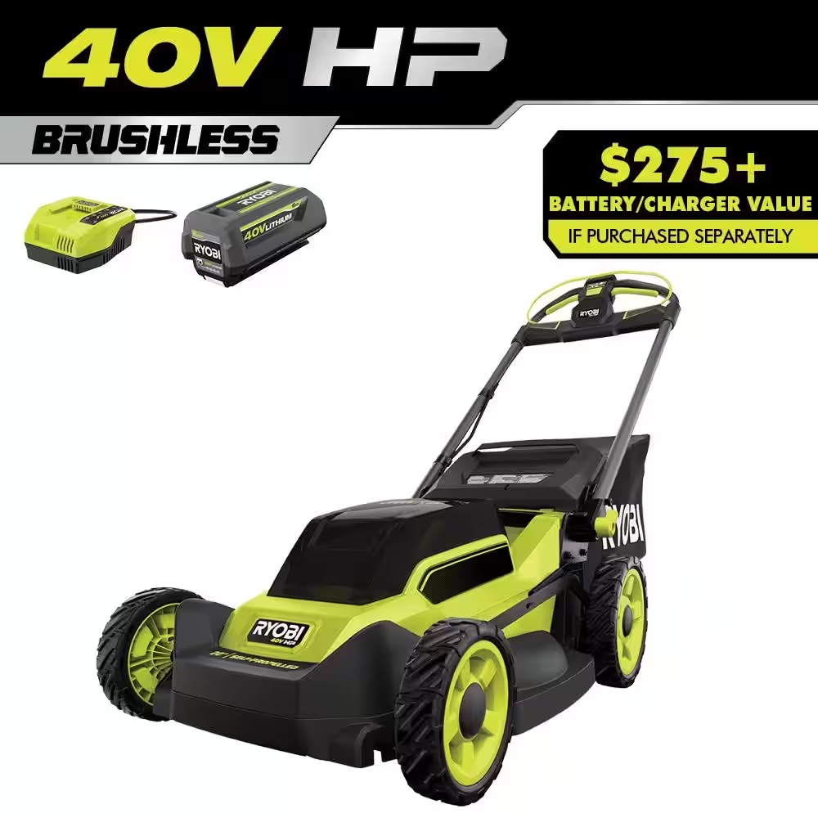
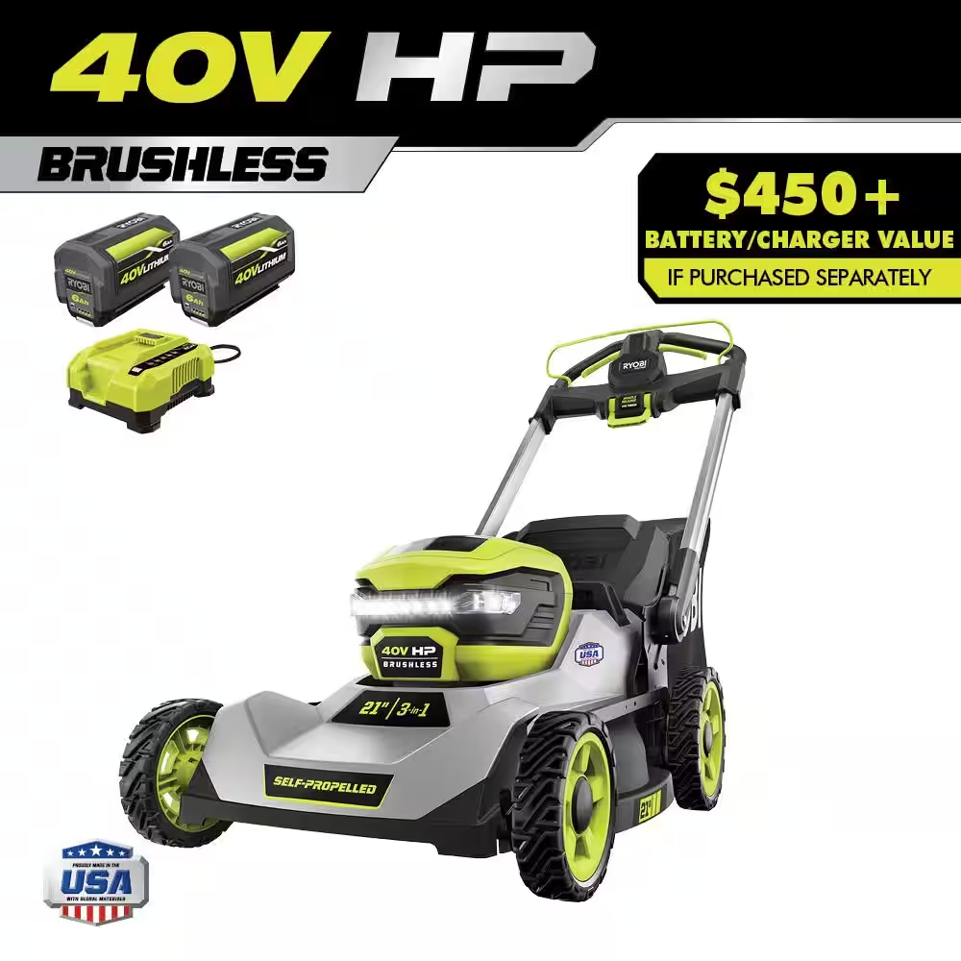
$499
$699
Notes:
I worked at home depot over the summer, and the most common question I got was
[NEXT SLIDE]
What’s the difference between these two products?
These two lawnmowers are perfect examples of the types of products id be asked to compare on a day to day basis.

Slide 4
01
02
03
The Goal
Have a LLM that can quickly compare two products together
The Models
What models I chose to use for my project
My Application
My demo application
Notes:
In this presentation I will go over a more detailed goal for the project, what models I chose to use, my demo application, and the results of what model I think worked the best for this task.

Slide 5
01
The Goal
Notes:
My goal for this project is to have an app that customers or associates could use, where you can scan two products, and a large language model would compare and summarize the differences between the two products in a easy to understand way.

Slide 6
02
The Models
Notes:
I chose to test a variety of models for this project.

Slide 7

LLAMA 7B, 13B, 70B
Notes:
None of the LLAMA models from facebook worked well at all. It often times just ignored all user input, and make up random fake information that had nothing to do with the input.
I did not see a difference between the models besides speed. 13b was slower then 7b, and 70b was slower than 13b.

Slide 8

Openhermes 2.5 mistral 7B
Notes:
Open-herm-ez 2.5 mistr-ial 7B was definitely better at this task. It did though however lump the results into a giant block of text, and did not apply any formatting like bullet points to make it easier for the end user to read.

Slide 9

Wizard 13B
Notes:
Wizard 7B was even better at performing this task. It gave detailed responses and compared the two products in an easy to read way. Unfortunately sometimes it would just crash and burn, and just return a new line as its response. I have no clue why as of now.

Slide 10

Orca 2 7B, 13B
Notes:
Orca 2 7B and 13B were the best local model I tested. I did not notice a difference between the two of them besides speed. 13B is slower predictably.
I had no issues with the model, and it compared the products without making up facts in a very easy to understand fashion.

Slide 11

GPT 3.5 & 4
Notes:
GPT 3.5 & 4 were the best online model I tested. GPT 4 tends to babble on a bunch while 3.5 does this task very well
I had no issues with the model, and it compared the products without making up facts in a very easy to understand fashion.

Slide 12
03
My Demo Application
Notes:
Here is a demo of my program

Slide 13
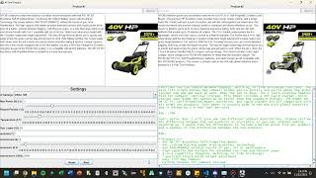

Slide 14
Any Questions?
Notes:
Any questions?

